Slide 1
MAP QUIZ

Slide 2
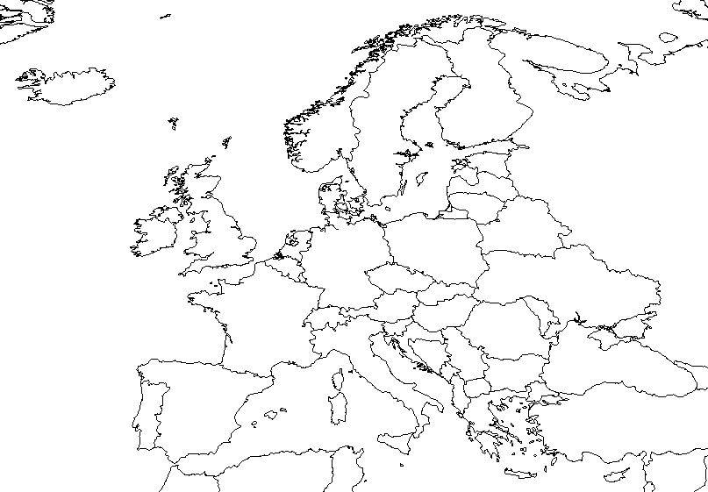
Find England / Great Britain / United Kingdom
Great Britain is the entire island that the red arrow is pointing to
England is the southern part of that island
Both arrows together are called the United Kingdom

Slide 3
Find Spain

Slide 4
Find Ukraine

Slide 5
Find Austria

Slide 6
Find Turkey

Slide 7
Find Norway

Slide 8
Find France

Slide 9
Find Germany

Slide 10
Find the Netherlands

Slide 11
Find Belgium

Slide 12
Find Switzerland

Slide 13
Find Italy

Slide 14
Find Russia

Slide 15
Find Poland

Slide 16
Find Serbia

Slide 17
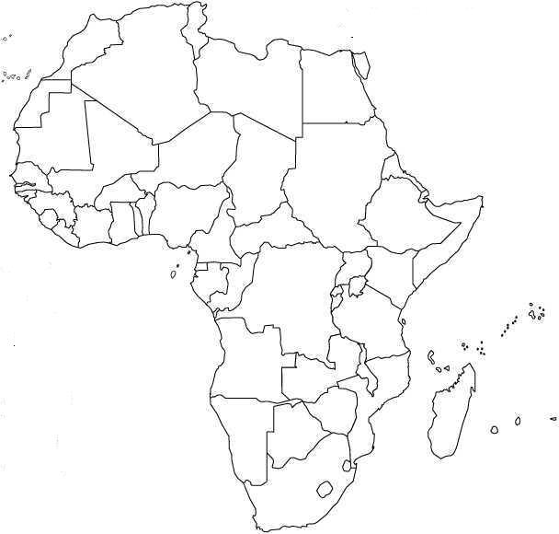
Find South Africa

Slide 18
Find Rwanda

Slide 19
Find Nigeria

Slide 20
FIND LIBYA

Slide 21
Find Sudan

Slide 22
Find Democratic Republic of the Congo

Slide 23
Find Somalia

Slide 24
Find Kenya

Slide 25
Find Morocco

Slide 26
Find Liberia

Slide 27
Find Ethiopia

Slide 28
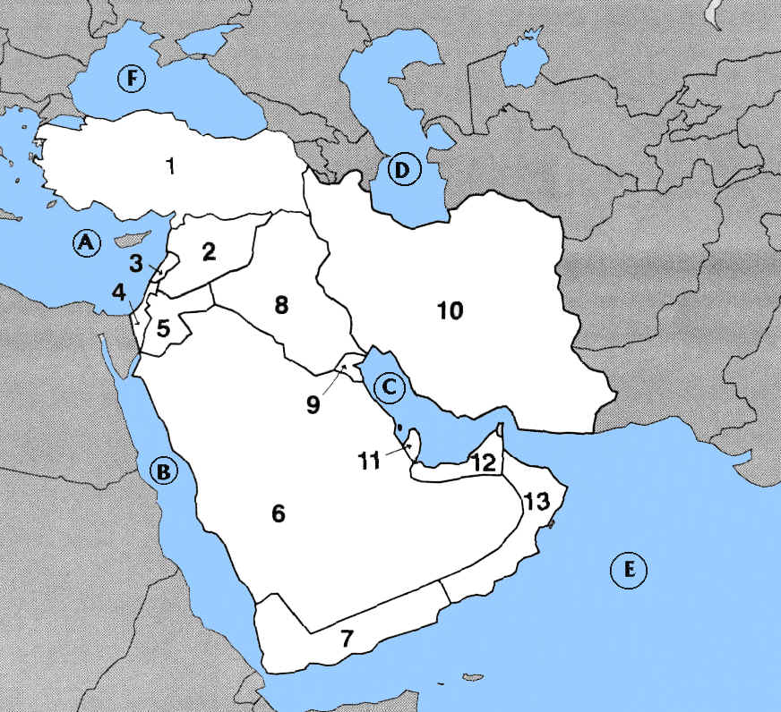
Find Egypt

Slide 29
Find Saudi Arabia

Slide 30
Find Iran

Slide 31
Find Afghanistan

Slide 32
Find Israel

Slide 33
Find Qatar

Slide 34
Find Iraq

Slide 35
Find Syria

Slide 36
Find Kuwait

Slide 37
Find Pakistan

Slide 38
Find United Arab Emirates

Slide 39
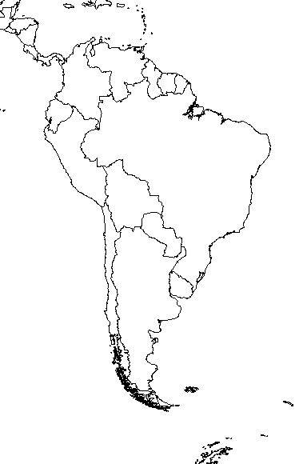
Find Peru

Slide 40
Find Chile

Slide 41
Find Venezuela

Slide 42
Find Columbia

Slide 43
Find Brazil

Slide 44
Find Panama

Slide 45
Find Ecuador

Slide 46
Find Costa Rica

Slide 47
Find Nicaragua

Slide 48
Find Bolivia

Slide 49
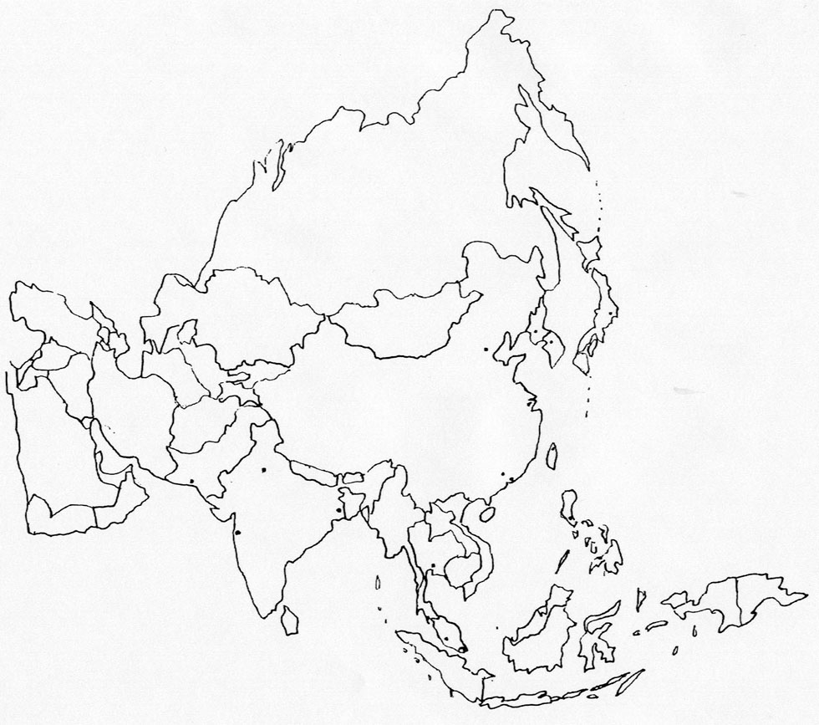
Find Taiwan

Slide 50
Find China

Slide 51
FIND INDIA

Slide 52
Find North Korea

Slide 53
Find Thailand

Slide 54
Find Japan

Slide 55
Find Indonesia

Slide 56
Find Kazakhstan

Slide 57
Find Philippines

Slide 58
Find South Korea

Slide 59
Find Mongolia

Slide 60
Find Vietnam

